Slide 1

Scholarship and Financial Aid Management System
REVIEW 2
PROJECT ID: PROJECT 27 | PLATFORM: MYSQL WORKBENCH
Presented by: M Sai Manoj - 25WU0102139

Slide 2


Project Architecture & ER Diagram
Core Relational Schema
Our database architecture relies on a robust Entity-Relationship model connecting six core entities:
• Students & Schemes
• Applications & Bank Details
• Sanctions & Disbursements
This structured layout guarantees that every financial transaction traces back to a verified student and an active scholarship scheme, forming the backbone of our relational schema.
Key Entity Cardinalities
The ER diagram illustrates key cardinalities designed to enforce data integrity and secure routing:
One-to-Many Relationship
Maintained between Students and Applications to support multiple scholarship submission attempts over time.
One-to-One Mapping
Configured for Bank Details to ensure precise, tamper-proof, and secure financial routing.
Together, these mappings ensure seamless verification from application submission to final disbursement.

Slide 3
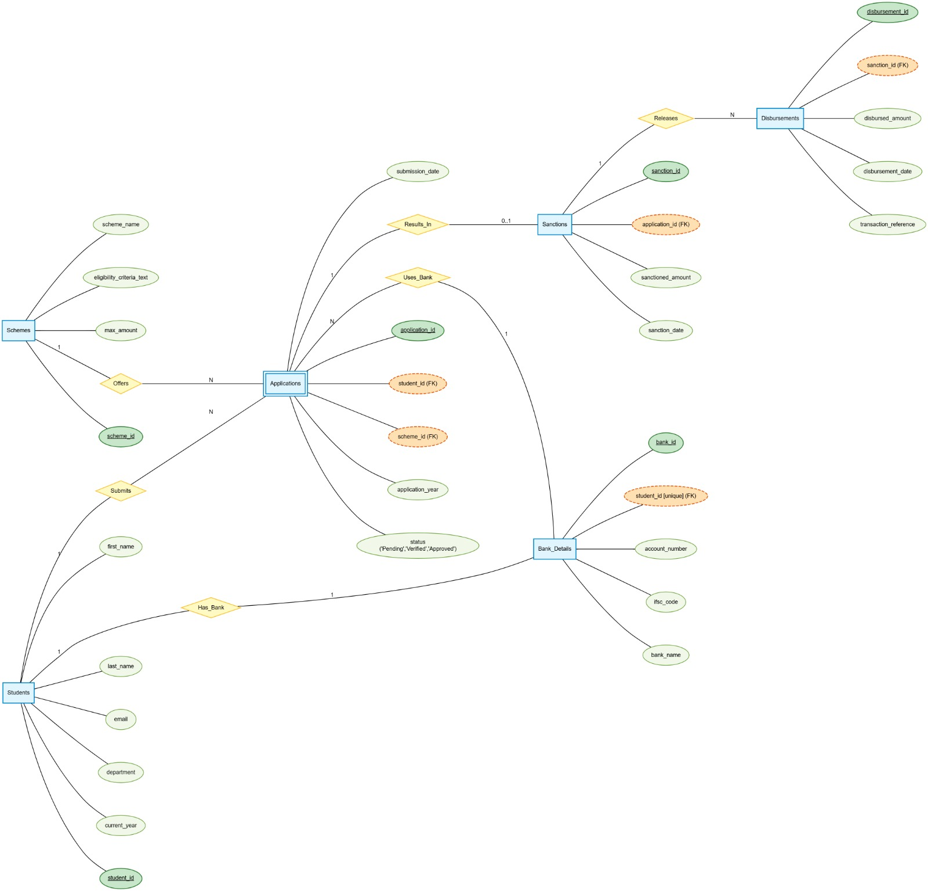
ER Diagram

Slide 4
Database Normalization & Data Dictionary
Schema Normalization (3NF)
To eliminate data redundancy and insertion anomalies, the database schema is normalized up to the Third Normal Form (3NF).
We resolved partial dependencies by ensuring all attributes depend entirely on primary keys, and removed transitive dependencies across financial records.
Data Dictionary
Attribute
Data Type
Key
Allowable Values / Notes
app_id
BIGINT
PK
Unique application identifier
app_status
VARCHAR(20)
-
'Pending', 'Approved', 'Rejected', 'Disbursed'
disb_amount
DECIMAL(12,2)
-
Numeric value >= 0.00 (Financial record)
schema_meta
TEXT / SUMMARY
-
Comprehensive summary of tables, primary keys, & data types ensuring structural consistency.

Slide 5

DDL Scripts & Business Integrity Constraints
UNIQUE Constraints
Implemented to guarantee a student can submit only one application per scheme per academic year, ensuring strict single-submission enforcement at the schema level.
CHECK Constraints
Maintain valid operational states throughout the system lifecycle, such as capping sanction limits and restricting application statuses strictly to active, pending, or closed.
Foreign Keys
Establish strict referential integrity between applications, bank details, and final disbursements, effectively preventing orphaned financial records and keeping relational structures cohesive.

Slide 6


Sample Data & Population
To validate our schema, we populated the relational tables with a realistic, comprehensive test dataset. This mock data spans all core entities, including extensive student profiles, active scholarship schemes, and corresponding application records. The data simulates various real-world scenarios, including partial disbursements and rejected sanctions, providing a rigorous foundation for testing complex SQL queries, validating constraint triggers, and ensuring the system performs accurately under typical administrative workloads.
Core Entity
Sample Scenarios & Data Attributes
Population Volume
Validation Target
Student Profiles
Demographics, academic standing, enrollment verification
10,000 Profiles
FK Integrity & Indexing
Scholarship Schemes
Active funding rules, eligibility criteria, budget caps
250 Active Schemes
Constraint Triggers
Application Records
Multi-tier submissions, pending reviews, approvals
45,000 Records
Complex SQL Queries
Disbursements & Sanctions
Partial disbursements, rejected sanctions, audit logs
38,200 Transactions
Administrative Workloads

Slide 7

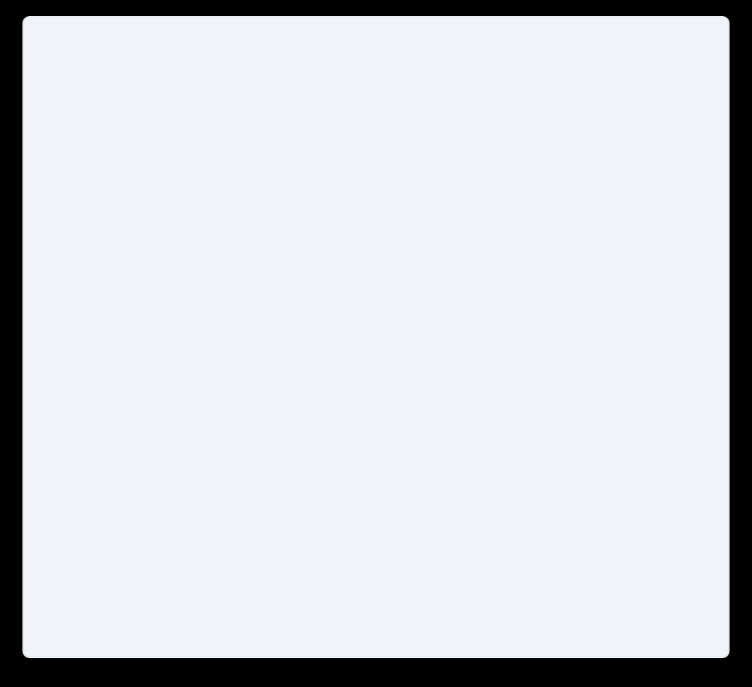
SQL Implementation - Joins & Subqueries
pending_applications_analysis.sql
Relational Logic & Analytics
Our implementation leverages advanced SQL capabilities to extract actionable insights and execute robust operational queries across the system.
• Relational Table Joins
Utilizes complex INNER and LEFT JOINs to link Student, Application, and Scheme tables, efficiently isolating pending applications for administrative review.
• Nested Financial Subqueries
Employs nested subqueries to calculate advanced financial metrics, identifying students whose total sanctioned amounts exceed the average scheme threshold.
• Operational Precision
Demonstrates the system's ability to handle multi-table relational logic and deliver precise operational data.
-- Isolate pending applications & high sanctions
SELECT std.student_id, std.name, app.amount
FROM Student std
INNER JOIN Application app
ON std.student_id = app.student_id
LEFT JOIN Scheme sch
ON app.scheme_id = sch.scheme_id
WHERE app.status = 'PENDING'
AND app.amount > (
-- Financial metric: Exceeds average
SELECT AVG(sub_app.amount)
FROM Application sub_app
WHERE sub_app.scheme_id = sch.scheme_id
);

Slide 8
SQL Aggregations & Views
SQL Aggregation Logic
To support administrative decision-making, we implemented SQL aggregations using GROUP BY clauses with aggregate functions like SUM and COUNT.
The system generates real-time statistics on total funds disbursed and application volumes per scholarship scheme.
Secure View Architecture
We created secure SQL Views, which encapsulate complex joins to provide faculty and auditors with streamlined, read-only access to critical reporting metrics.
This architecture ensures precise reporting capabilities without exposing underlying table structures.

Slide 9


Prototype Demonstration & Progress
MySQL Workbench
Fully Operational Environment
100% Success
DDL & DML Script Execution
ACID Compliant
COMMIT & ROLLBACK Verified
Transaction Handling & Integrity
Integrated robust transaction control to guarantee strict data consistency across multi-step financial workflows.
START TRANSACTION;
-- Multi-step financial disbursement
EXECUTE UPDATE_DISBURSEMENT(...);
COMMIT; -- ROLLBACK on error
Test Execution & Verification
Simulated concurrent administrative operations to validate real-time status updates and core system logic.
• Application Processing: Accurately ingests and parses submitted financial applications.
• Sanction Statuses: Automatically updates approval state during state transitions.
• Concurrency Control: Maintains absolute data integrity under simulated multi-user load.

Slide 10


Conclusion & Q&A
Review 2 Summary
In Review 2, we have successfully delivered a fully normalized database schema, enforced business integrity constraints, and demonstrated complex SQL querying capabilities within MySQL Workbench.
The foundational architecture is stable, and the test data validates our relational logic.
We are now prepared to transition into application integration.
Project Readiness
Architecture is validated, fully tested, and ready for live query execution and application layer integration.
Panel Feedback & Q&A
We welcome the panel's feedback and are ready to execute live query demonstrations or answer any questions regarding the database design.

